Slide 1


Ryan Ezekiel WenLongJie Zhang
25 AUG 2025

Slide 2

Outline
Executive Summary
Introduction
Methodology
Results
Conclusion
Appendix

Slide 3
Executive Summary
Summary of methodologies
Data collection through API requests and web scraping
Exploratory data analysis with Python visualizations and SQL queries
Interactive visualization with Folium
Dashboard using Plotly Dash
Predictive analysis using machine learning (scikit-learn)
Summary of all results
Success has improved over time
Logistic regression and a decision tree classifier were found to be equally as effective at predicting launch outcomes

Slide 4
Introduction
SpaceX has been a major disruptor in the aerospace industry. One of their innovations has been reusing their first stage boosters, which are usually discarded after launch. If their rockets land successfully, it’s not just a successful mission, it means money saved. Using data from both SpaceX’s REST API and publicly scraped Wikipedia data, machine learning models were built and tested to see if launch outcomes could be predicted accurately.
Questions:
What factors effect a successful launch?
What machine learning model most accurately predicts launch outcomes?
How does landing success change over time?

Slide 5

Section 1

Slide 6
Methodology
Executive Summary
Data collection methodology:
SpaceX REST API
Werb Scraping Wikipedia
Perform data wrangling
Launch types were transformed into a class column indicating success/failure
Perform exploratory data analysis (EDA) using visualization and SQL
Perform interactive visual analytics using Folium and Plotly Dash
Perform predictive analysis using classification models
Evaluated the accuracy of multiple cross-validated classification models

Slide 7
Data Collection
Data was collected from SpaceX’s REST API and scraping Wikipedia for additional launch data. This was done to obtain additional data not available in either source alone.
Some of these features are:
-Payload mass
-Whether grid fins were present or not
-Number of reuses
-Longitude and latitude

Slide 8
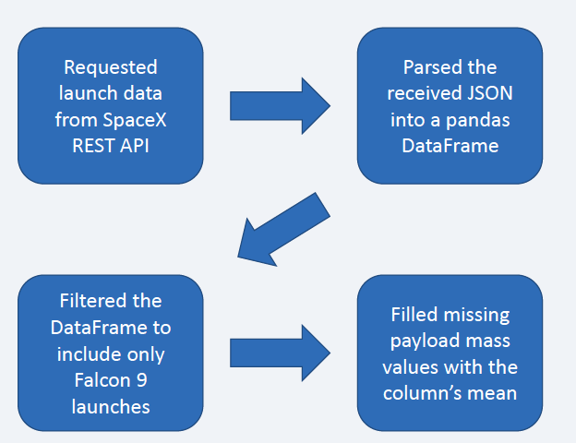
Data Collection – SpaceX API
Data was requested from the SpaceX REST API
The JSON response was parsed into a pandas DataFrame
The DataFrame was filtered for Falcon 9 data only
The payload mass column’s missing values were imputed with the column’s mean
The data was saved for later use
SpaceX API calls notebook: https://github.com/ryanwljzhang/ibmdatascience/blob/main/jupyter-labs-spacex-data-collection-api.ipynb

Slide 9
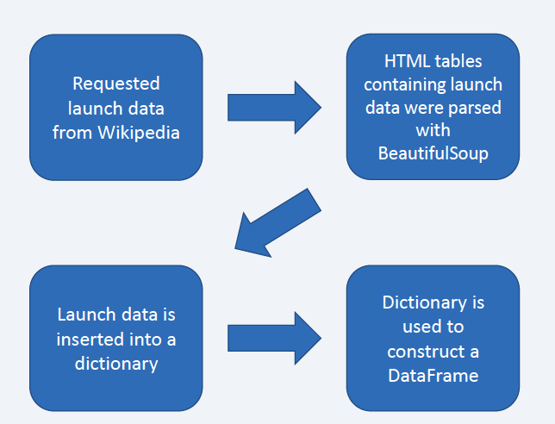
Data Collection - Scraping
An HTTP request was sent to retrieve the content of a Wikipedia page containing SpaceX launch data
Using BeautifulSoup, the HTML object was parsed
Table headers and values were inserted into a dictionary
The dictionary was used to construct a pandas DataFrame
Web scraping notebook: https://github.com/ryanwljzhang/ibmdatascience/blob/main/jupyter-labs-webscraping.ipynb

Slide 10
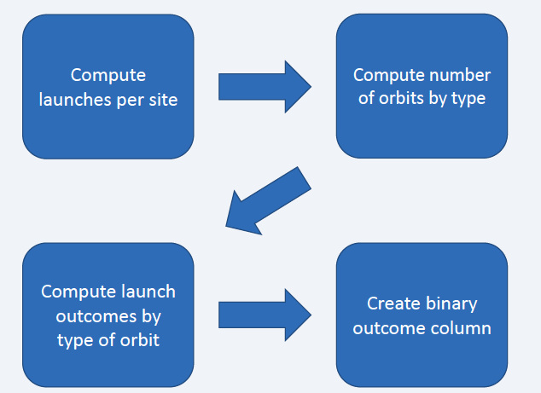
Data Wrangling
Multiple labels were present for describing launches, which were simplified into a binary column of successes/failures
Data wrangling notebook: https://github.com/ryanwljzhang/ibmdatascience/blob/main/labs-jupyter-spacex-Data%20wrangling.ipynb

Slide 11
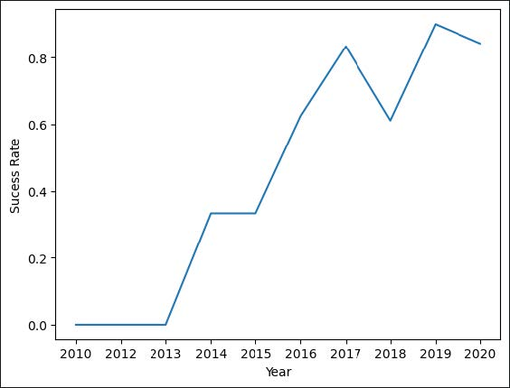
EDA with Data Visualization
Plotted various graphs:
Scatterplots: payload mass, launch site, orbit, payload mass vs. launch site, payload mass vs. orbit
Bar graph: orbit vs. success rate
Line graph: year vs. success rate
EDA data visualization: https://github.com/ryanwljzhang/ibmdatascience/blob/main/edadataviz.ipynb

Slide 12
EDA with SQL
Queried unique launch site names
Displayed 5 records where the launch site’s name began with ‘CCA’
Summed the total mass of all payloads
Calculated the average mass carried by F9 v1.1 boosters
Displayed the date of the first successful ground pad landing
Displayed names of boosters that have succeeded in drone ship with payload mass between 4000 and 6000 kg
Listed total number of successful and failed mission outcomes
Listed all booster versions that have carried the maximum payload mass
Listed the month, landing outcome, booster version, and launch site for drone ship failures in 2015
Ranked landing outcomes between 6/4/2010 and 3/20/2017 in descending order
SQL notebook: https://github.com/ryanwljzhang/ibmdatascience/blob/main/jupyter-labs-eda-sql-coursera_sqllite.ipynb

Slide 13
Build an Interactive Map with Folium
Placed circles with labels to highlight the various launch sites
laced a marker cluster containing markers for each launch (green for success red for fail) to visually demonstrate the success rate of each launch site
Lines going from Cape Canaveral Space Launch Complex 40 to the nearest coastline, railroad, highway, and city with markers for their distance to highlight landmark distance trends across launch sites
Map HTML: https://github.com/ryanwljzhang/ibmdatascience/blob/main/map.html
Folium notebook: https://github.com/ryanwljzhang/ibmdatascience/blob/main/lab_jupyter_launch_site_location.ipynb

Slide 14
Build a Dashboard with Plotly Dash
Dropdown menu to select data for all sites or a specific one
Pie chart
For all launch sites: displays portion of total successes that occurred at each site
For single sites: displays successes and failures for that site
Scatterplot graphing payload mass against success for selected sites, with points colored based on booster version
Slider to change range of payload masses displayed in the scatterplot
Dash lab: https://github.com/ryanwljzhang/ibmdatascience/blob/main/spacex-dash-app.py

Slide 15
Predictive Analysis (Classification)
Created Y data from Class column in DataFrame
Standardized X data
Split data into training and test sets
Used multiple models
Repeat for each model
Examined confusion matrix
Tested accuracy on test set
Displayed optimized hyperparameters and their score on training data
Used grid search cross-validation
Test accuuracy on test set
Tested logistic regression, SVM, and decision tree to predict launch outcomes. The decision tree and logistic regression tied for the best accuracy on the test set.
Note: the given grid search parameters for SVM were taking far too long to run with cross validation. Only RBF kernel was tested, but more values for other hyperparameters were tested to try to compensate for this.
Machine learning notebook: https://github.com/ryanwljzhang/ibmdatascience/blob/main/SpaceX_Machine%20Learning%20Prediction_Part_5.ipynb

Slide 16
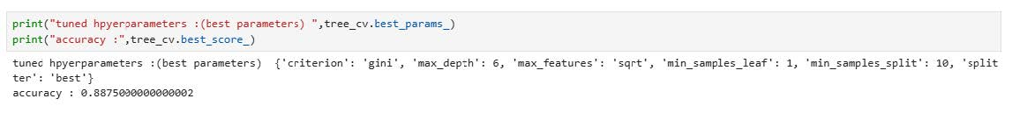
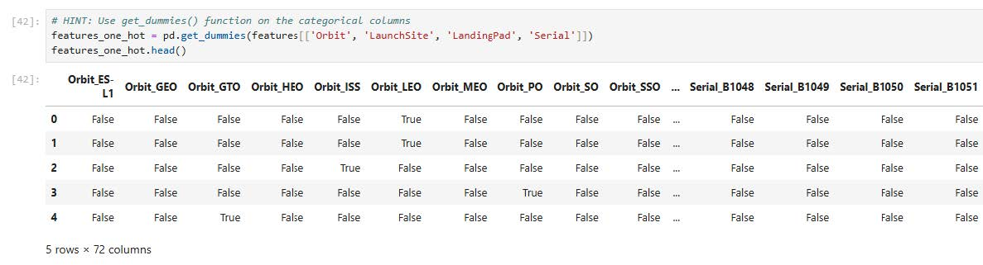
Results

Slide 17

Section 2

Slide 18
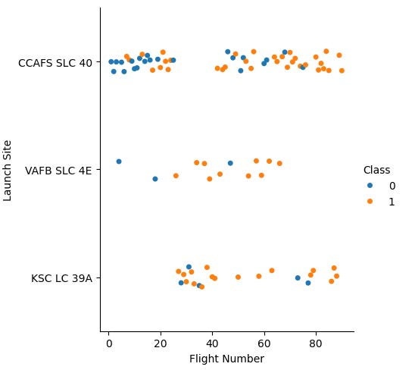
Flight Number vs. Launch Site
Scatterplot showing how successes changed over time and based on site.

Slide 19
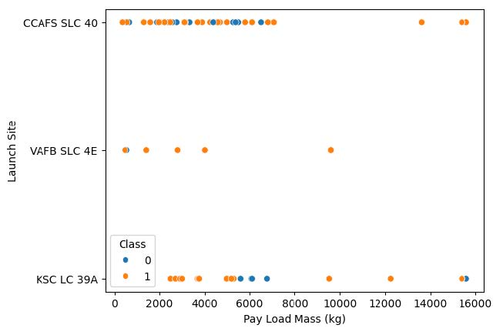
Payload vs. Launch Site
A scatter plot ofPayload vs. Launch Site.

Slide 20
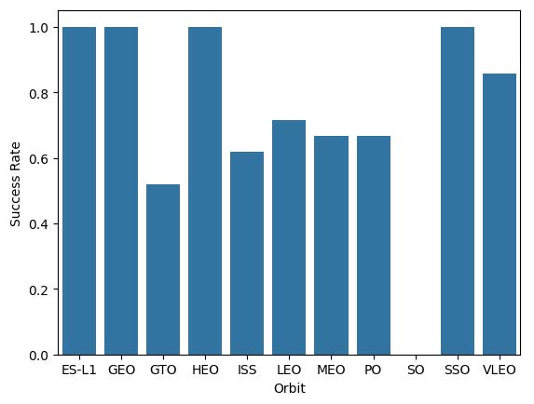
Success Rate vs. Orbit Type
Bar chart for the success rate of each orbit type.

Slide 21
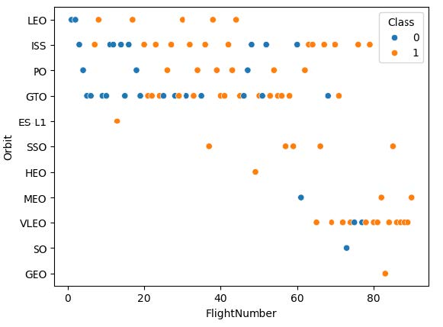
Flight Number vs. Orbit Type
Scatterplot of Flight number vs. Orbit type.

Slide 22
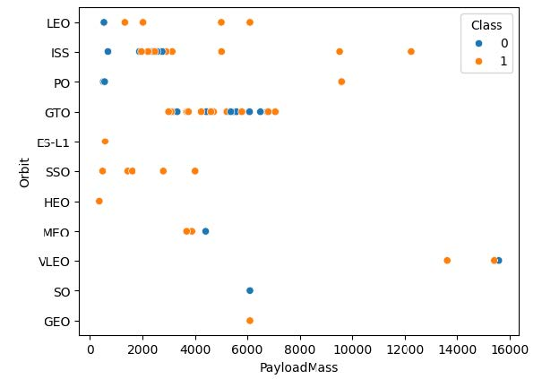
Payload vs. Orbit Type
Scatterplot of payload vs. orbit type.

Slide 23
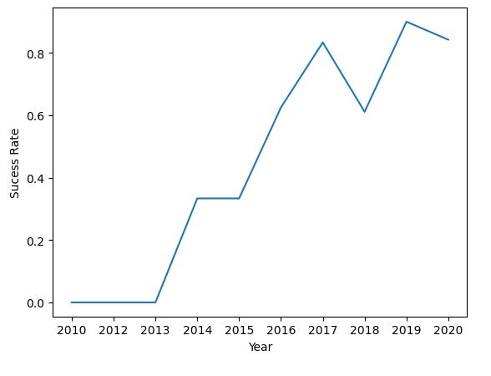
Launch Success Yearly Trend
Line plot showing success rate vs. year.

Slide 24
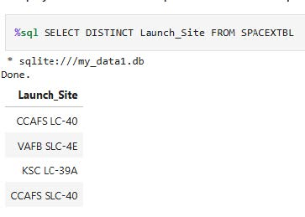
All Launch Site Names
Find the names of the unique launch sites

Slide 25
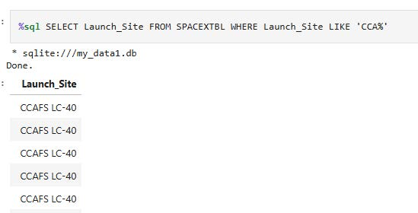
Launch Site Names Begin with 'CCA'
Find 5 records where launch sites begin with `CCA`

Slide 26
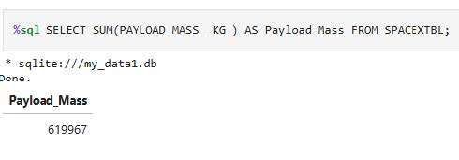
Total Payload Mass
Calculate the total payload carried by boosters from NASA

Slide 27
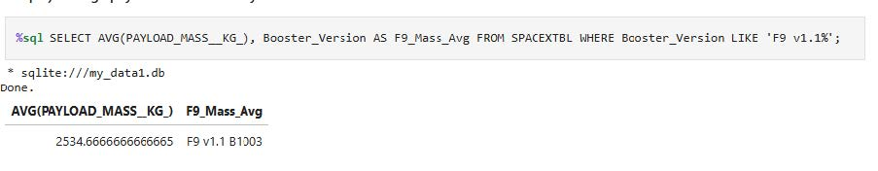
Average Payload Mass by F9 v1.1
Calculate the average payload mass carried by booster version F9 v1.1

Slide 28
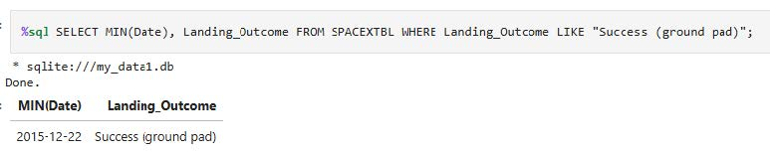
First Successful Ground Landing Date
Find the dates of the first successful landing outcome on ground pad

Slide 29
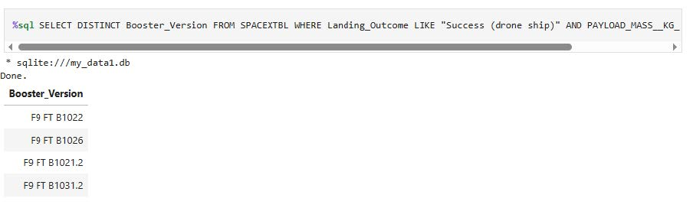
Successful Drone Ship Landing with Payload between 4000 and 6000
List the names of boosters which have successfully landed on drone ship and had payload mass greater than 4000 but less than 6000
%sqlSELECT DISTINCT Booster_VersionFROM SPACEXTBL WHERE Landing_OutcomeLIKE "Success (drone ship)" AND PAYLOAD_MASS__KG_ BETWEEN 4000 AND 6000

Slide 30
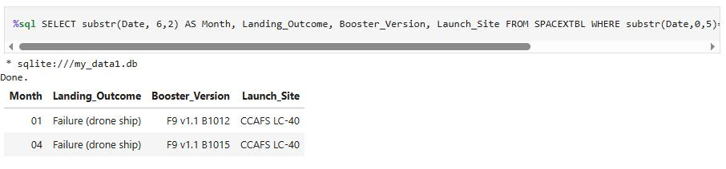
Total Number of Successful and Failure Mission Outcomes
Calculate the total number of successful and failure mission outcomes
%sqlSELECT DISTINCT Booster_VersionFROM SPACEXTBL WHERE PAYLOAD_MASS__KG_=(SELECT MAX(PAYLOAD_MASS__KG_) FROM SPACEXTBL);

Slide 31
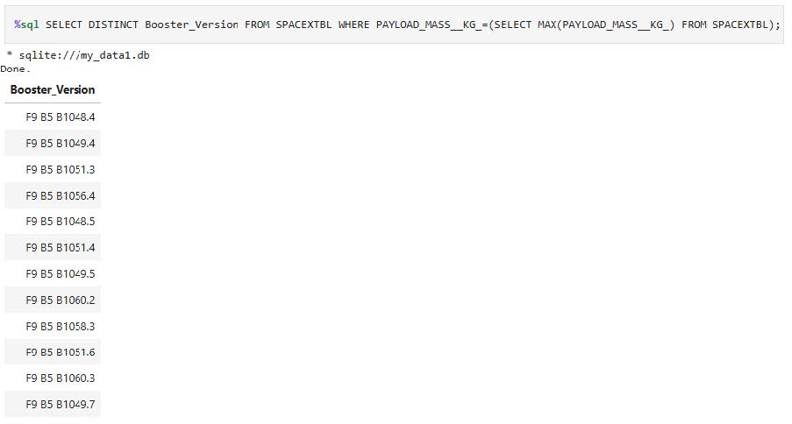
Boosters Carried Maximum Payload
List the names of the booster which have carried the maximum payload mass
%sqlSELECT DISTINCT Booster_VersionFROM SPACEXTBL WHERE PAYLOAD_MASS__KG_=(SELECT MAX(PAYLOAD_MASS__KG_) FROM SPACEXTBL);

Slide 32
2015 Launch Records
List the failed landing_outcomes in drone ship, their booster versions, and launch site names for in year 2015
%sqlSELECT substr(Date, 6,2) AS Month, Landing_Outcome, Booster_Version, Launch_SiteFROM SPACEXTBL WHERE substr(Date,0,5)='2015' AND Landing_OutcomeLIKE 'Failure%'

Slide 33
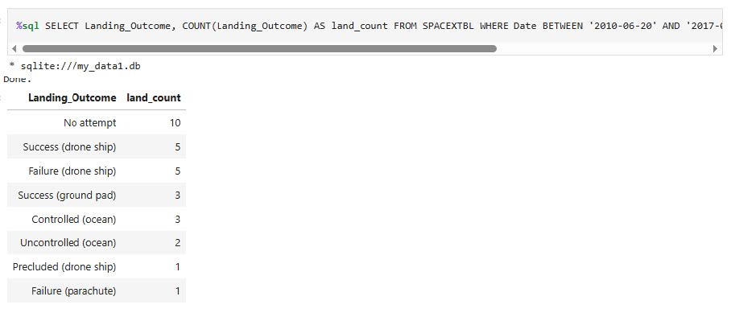
Rank Landing Outcomes Between 2010-06-04 and 2017-03-20
Rank the count of landing outcomes (such as Failure (drone ship) or Success (ground pad)) between the date 2010-06-04 and 2017-03-20, in descending order
%sqlSELECT Landing_Outcome, COUNT(Landing_Outcome) AS land_countFROM SPACEXTBL WHERE Date BETWEEN '2010-06-20' AND '2017-03-20' GROUP BY Landing_OutcomeORDER BY land_countDESC

Slide 34

Section 3

Slide 35
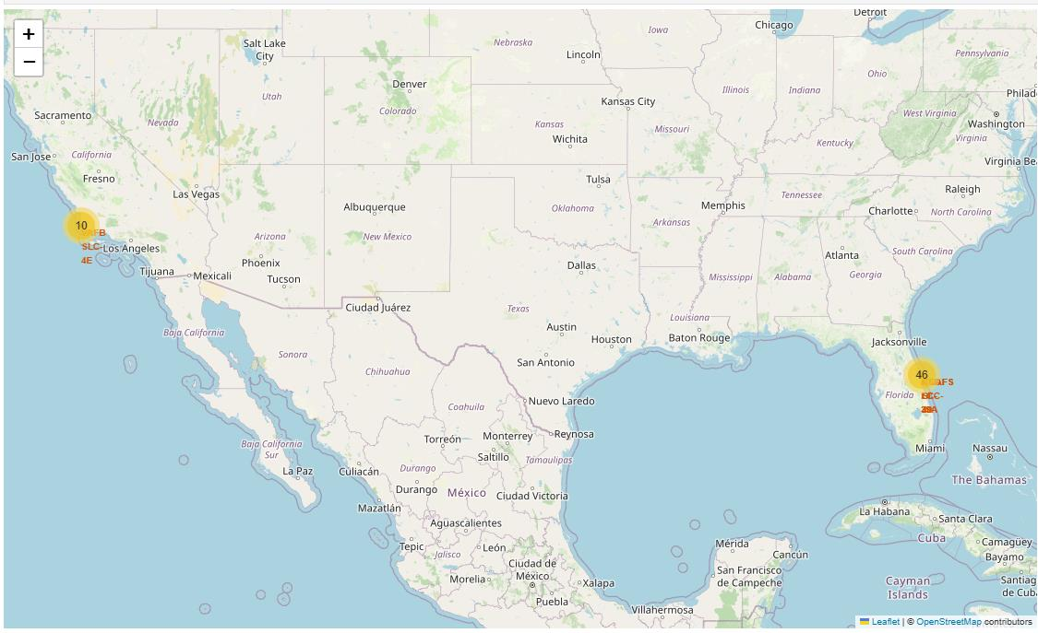
Launch Site Locations
Evidently, launch sites are all located in coastal states.

Slide 36
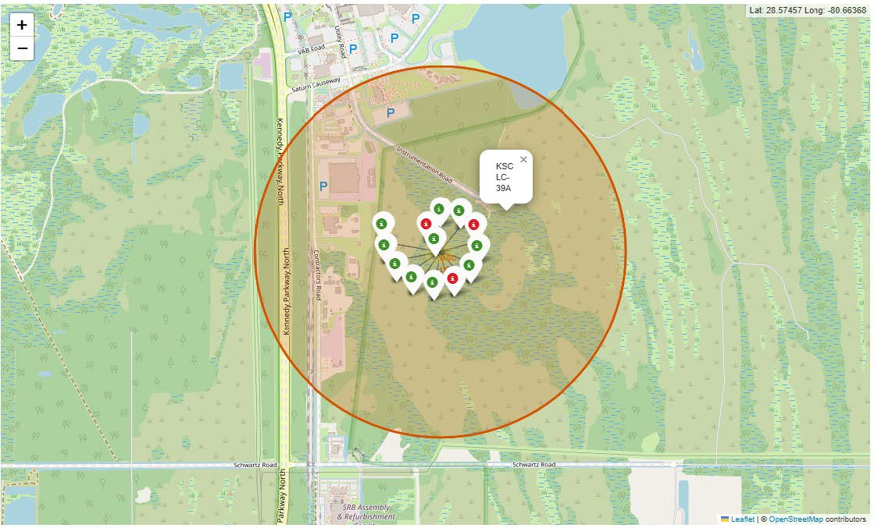
Most Successful Launch Site
The site with the highest success rate is KSC LC-39A.

Slide 37
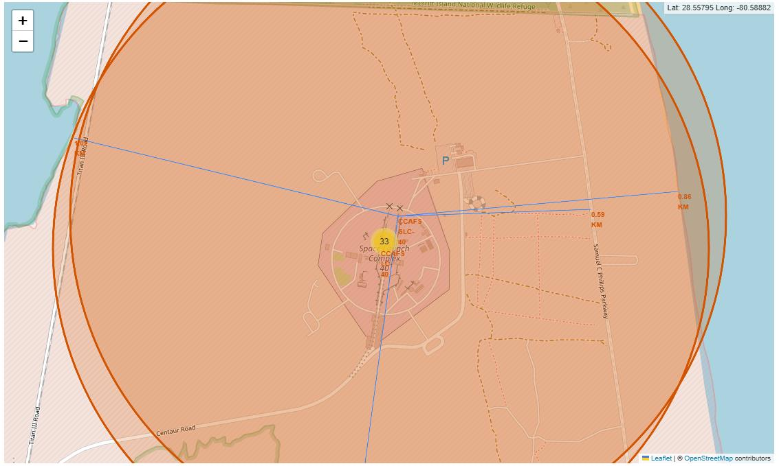
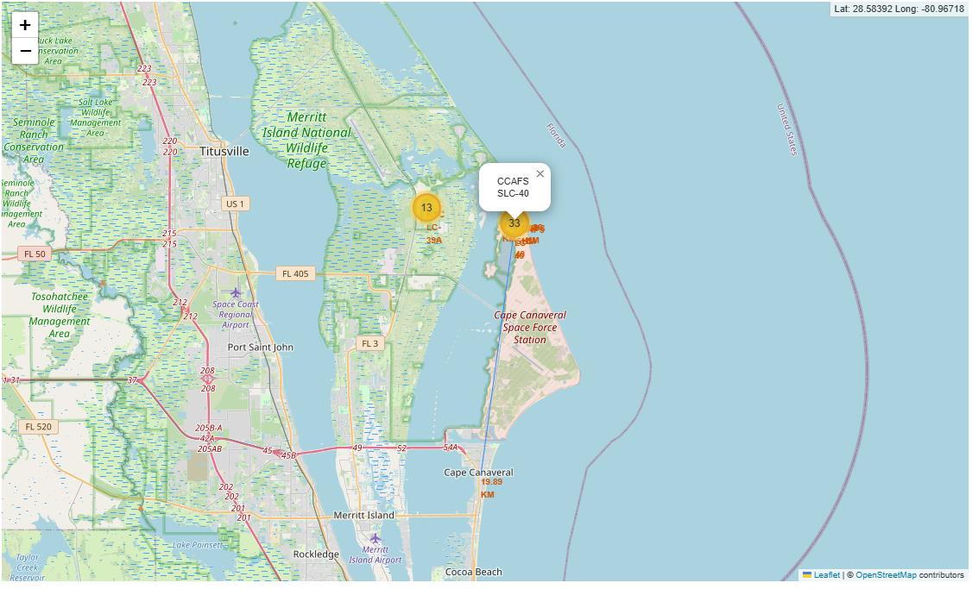
Landmark Distance from Launch Site
Analyzing the distance of landmarks from launch sites revealed trends.Railroads, highways, and the coastline are usually quite close to launch sites, while major cities are much further away. For example, a railroad, highway, and the coastline are within a kilometer from the launch site. The closest city is almost 20 kilometers away.

Slide 38
<Folium Map Screenshot 2>
Replace <Folium map screenshot 2> title with an appropriate title
Explore the folium map and make a proper screenshot to show the color-labeled launch outcomes on the map
Explain the important elements and findings on the screenshot

Slide 39
<Folium Map Screenshot 3>
Replace <Folium map screenshot 3> title with an appropriate title
Explore the generated folium map and show the screenshot of a selected launch site to its proximities such as railway, highway, coastline, with distance calculated and displayed
Explain the important elements and findings on the screenshot

Slide 40

Section 4

Slide 41
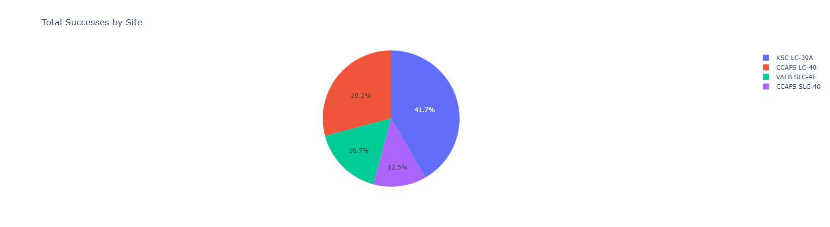
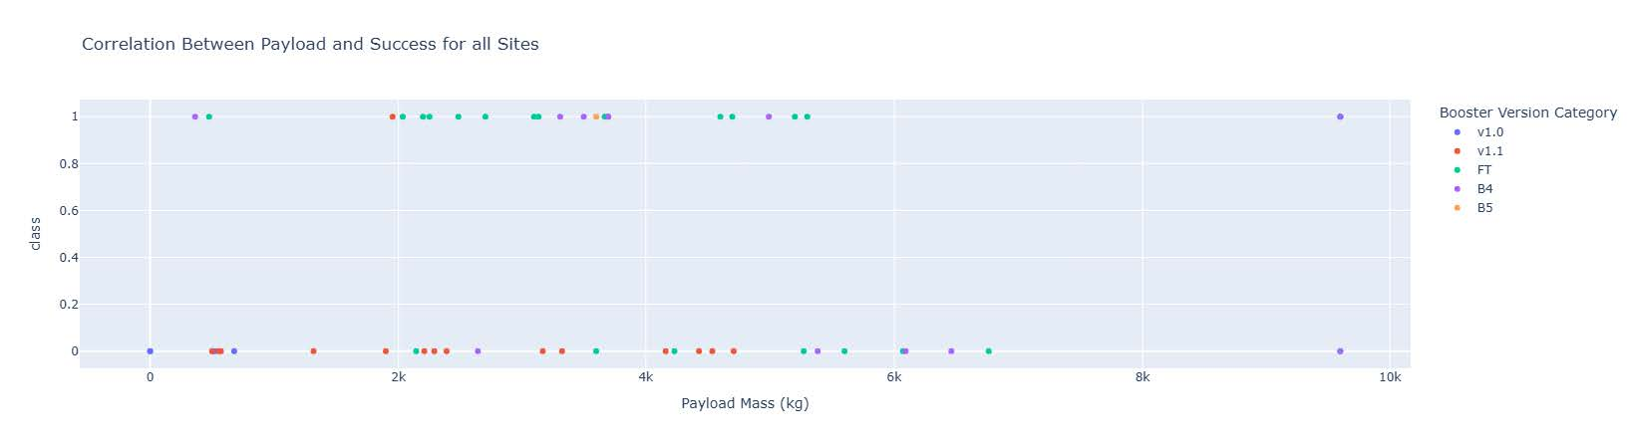
Finding across all sites
The site with the highest success rate is KSC LC-39A, while the site with the lowest success rate is CCAFS SLC-40. FT boosters seem to do well, but v1.1 boosters seem to perform poorly.

Slide 42
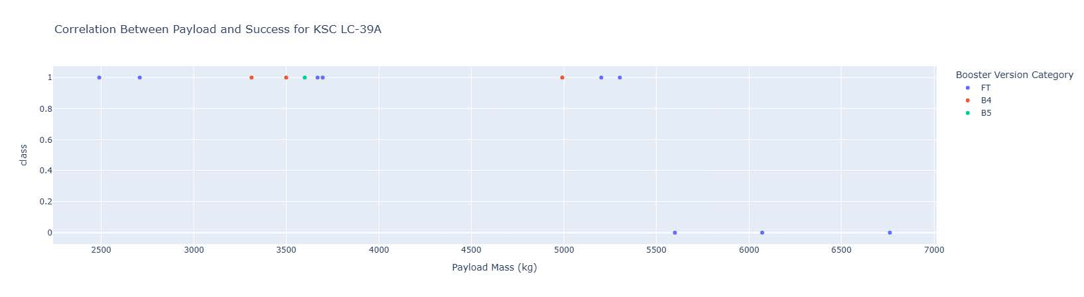
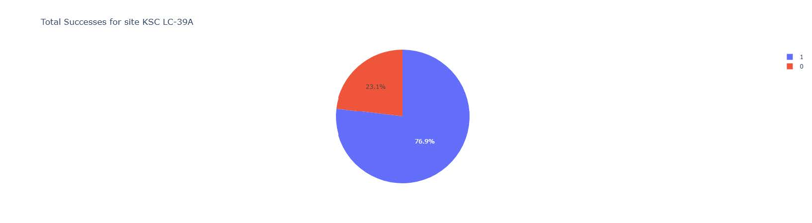
Highest Success Rate Site
The most successful site, KSC LC-39A, had successes ~77% of the time. After beginning to launch rockets with higher payloads and only using FT boosters, launches began to fail.

Slide 43
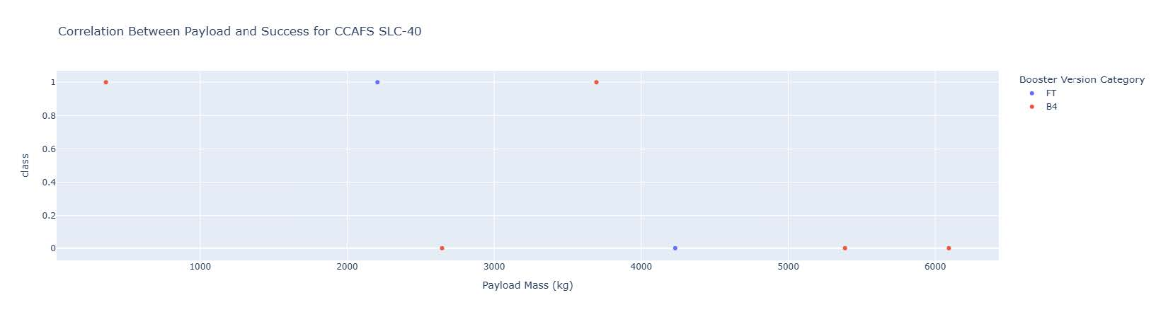
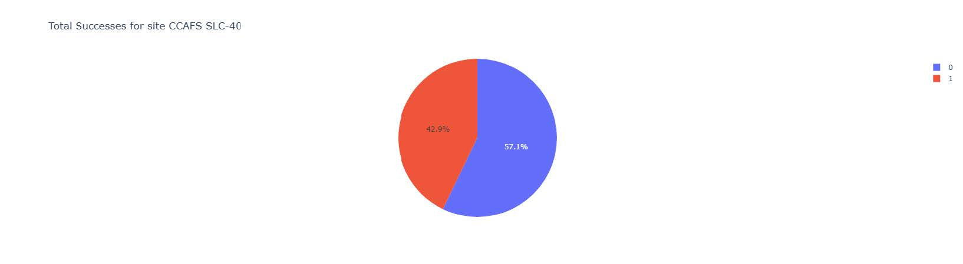
Lowest Success Rate Site
The site with the lowest success rate, CCAFS SLC-40, failed ~57% of the time. Booster type, payload mass, and time don’t seem to be correlated with success.

Slide 44

Section 5

Slide 45
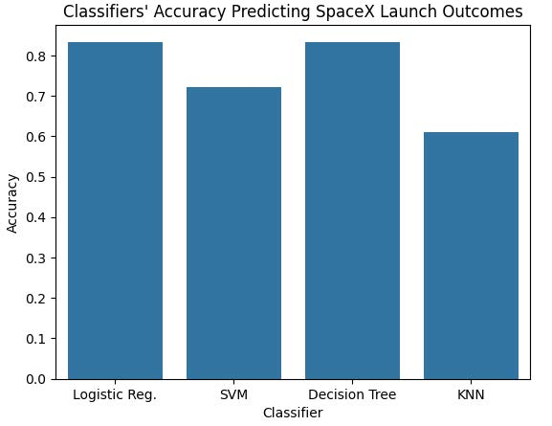
Classification Accuracy
Though decision tree had higher accuracy during cross-validation, it had the same accuracy as logistic regression when evaluated against the test dataset.

Slide 46
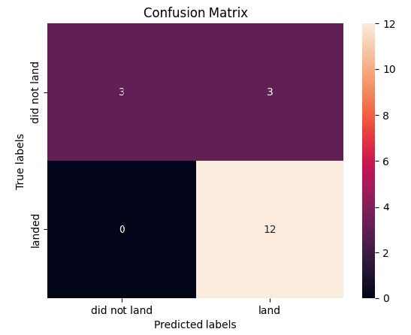
Confusion Matrix
Both the logistic regression and decision tree models had identical confusion matrices, only lacking in recall. These aren’t necessarily good models for this situation, but with experimentation a new model could sacrifice accuracy for higher recall. This would make it more overly cautious, but it would be much better at identifying launches that will fail.

Slide 47
Conclusions
KSC LC-39A has the highest success rate out of all sites.
Either decision tree or logistic regression are the best algorithms to use to predict success.
Launch sites have close proximity to the coast and are far from major cities.
Across all sites, time has increased success rate slightly.
Most launches with payload mass above 5000 kg fail.

Slide 48
Appendix
Include any relevant assets like Python code snippets, SQL queries, charts, Notebook outputs, or data sets that you may have created during this project

Slide 49


